Slide 1
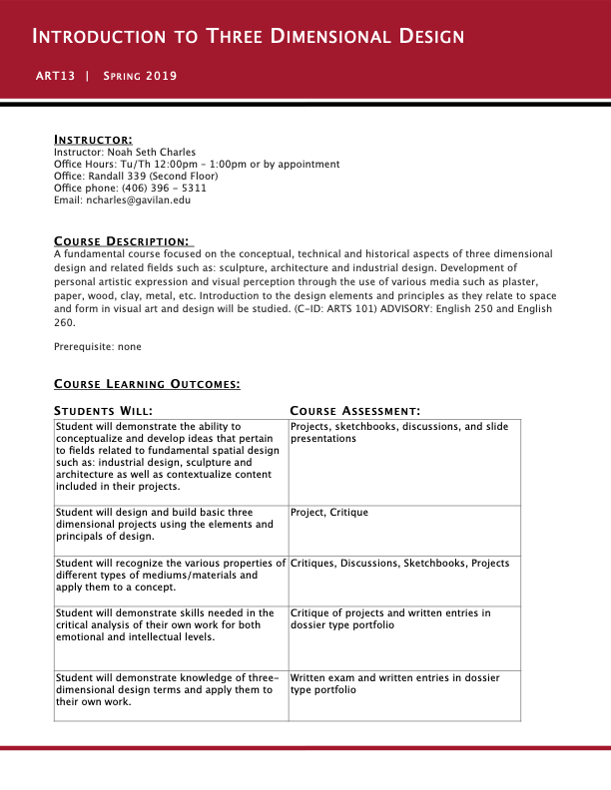
Notes:
Welcome to 3 - Dimensional Design….
My name is Noah Seth Charles…. You can call me Professor Charles, Mr. Charles, …and I’m also totally ok being on a first name basis with everyone… That said, I actually have never gone by my first name, so you can just feel free to call me Seth if you would like.
Later on we will do introductions and you can let me know if you have a preferred name other than what’s on my class roster….and also let me know if you have a preferred gender pronoun.
My office hours are Tuesday and Thursday from 12-1, then from 1-1:30 you will be able to find me here in this room setting up for class. Most days, I will also stay after class and be available as a resource for anyone that wants to stick around….. Of course, if those times don’t work for you, just let me know and we will set up an appointment to meet another time.
My phone and email are listed on here. I check my email multiple times a day, so if you email me and have not heard anything back within any given 24 hour period, it means I didn’t receive your message, so just check the address, and resend.
Because we only have a short amount of time today, I’ve summarized the course learning outcomes which we will go over shortly…. And we are going to skip around while reviewing the syllabus so we can get to everything we need to cover today….
————————

Slide 2
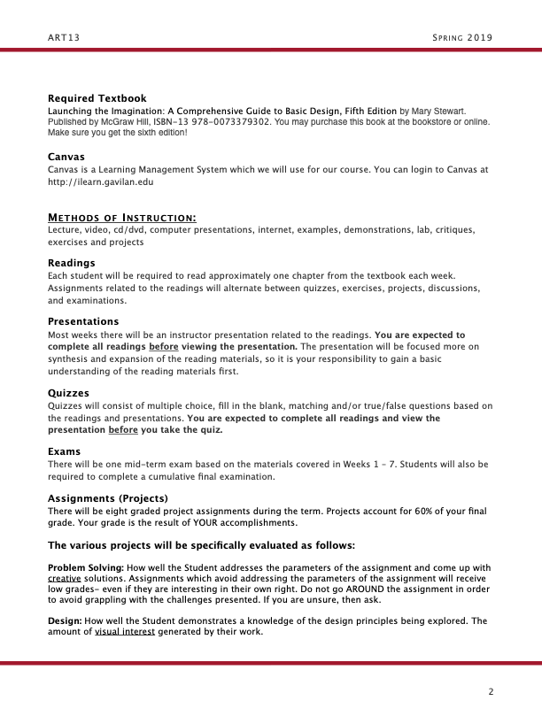
Notes:
You will need to buy or rent a text book…and this is what it will look like… just make sure it is the fifth edition.
We will utilize canvas for this course ….and all of my presentations will be uploaded on there as well as pdf copies of all “handouts.”
… After the first day, I won’t be using printed handouts, but instead, you can access everything as .pdf copies on canvas.
METHODS OF INSTRUCTIONS….what you can expect this semester…..
You are going to be reading about a chapter every week from the text book…which I know sounds like a lot….but trust me, it’s really basic information….mostly an introduction to the vocabulary we will be using throughout the course…. It’s also about a third pictures and images too… so totally not intimidating.
I will give a presentation each week that will expand on the concepts that the author introduces in the textbook…. Then, based off of that I will be doing regular demonstrations on equipment, materials, and techniques for each project.
We will have 4 quizzes that are based on the reading and my presentations….
Then we will also have a mid-term exam and a final cumulative exam based off of those quizzes.
Throughout the semester, you will also be working on a portfolio that will include your sketches….images of your maquette’s (or models)…. and photos of your finished work.
And probably most importantly, we will have 6 graded projects throughout the semester. These are what you will spend the most time working on….creating these physical 3-d objects….and they make up the bulk of your grade….60%……
And with that, we will skip down to grading…..
—————————-

Slide 3
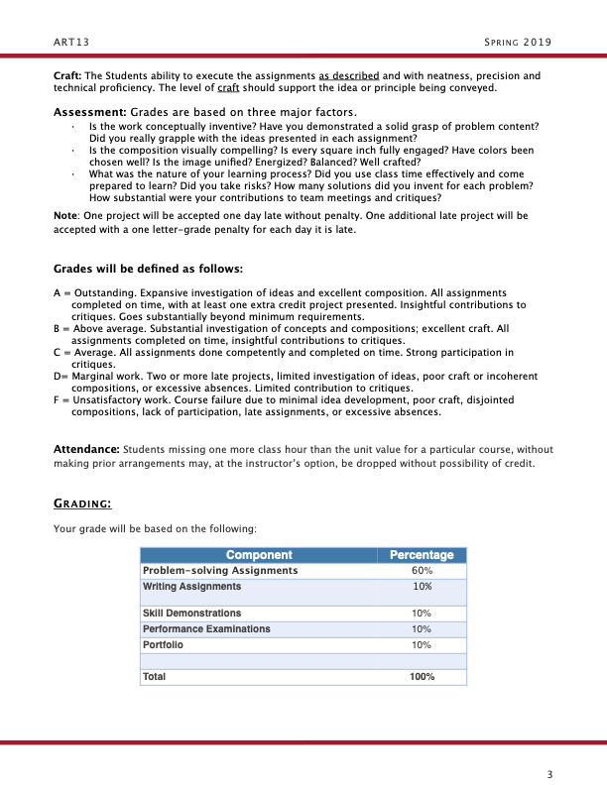
Notes:
As I said, 60% of your final grade will come from your completed projects….those are going to be evaluated based off 3 factors…
#1)…your problem solving abilities…. So coming up with creative solutions to the challenges that are presented to you…..
#2)… Based off of your design… the amount of visual interested generated with each project… which will also demonstrate your knowledge of the design principles that we will learn through the semester….
And 3,….also off of craft….your ability to complete the projects with a high level of neatness and precision.
Next component will be Writing Assignments…..These will be entries in your portfolio in which you write about each project and include a summary of the course at the end of the semester.
Then 10% will be based off of skill demonstrations….showing technical proficiency with the various mediums and materials that we will be using.
Another 10% will come from exams….so your quizzes, mid-term, and final exam which I’ve mentioned.
And the final 10% comes from your completed portfolio, including documentation of all of your projects.
And with that….we are going to jump ahead a few pages and talk about what I would really like for you to get out of this course…. [SKIP TO 6th SLIDE]
—————————-

Slide 4
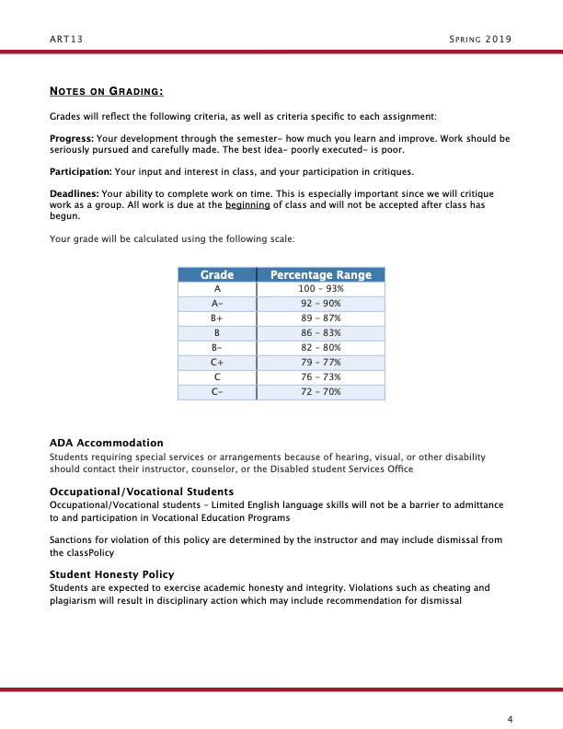

Slide 5
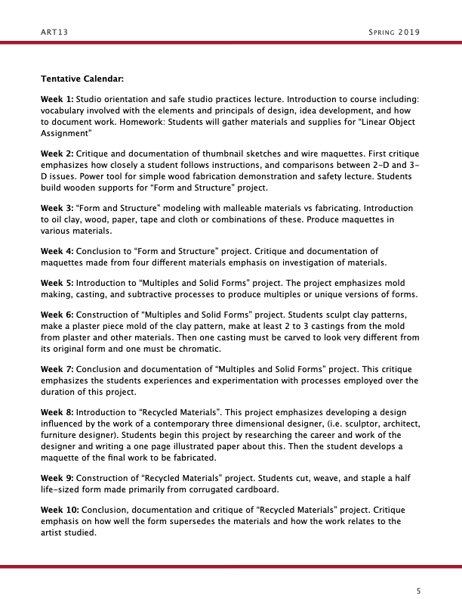

Slide 6
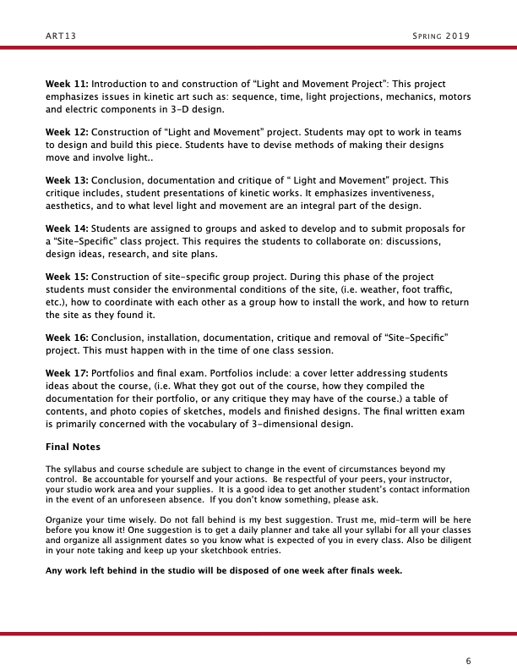

Slide 7
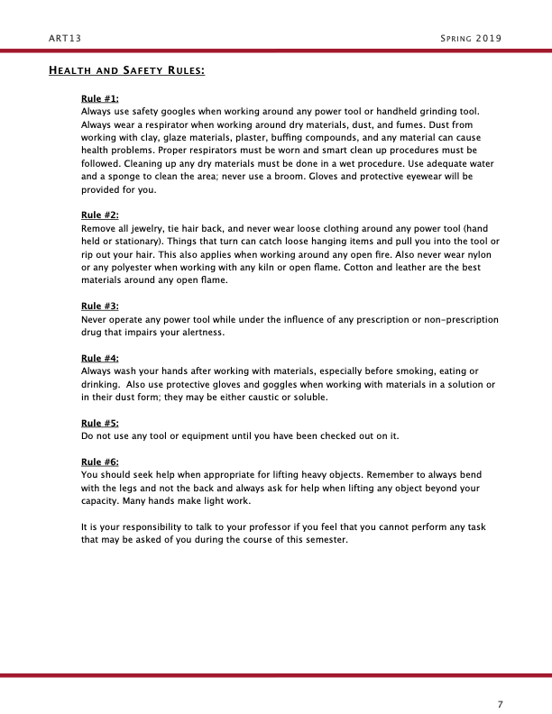

Slide 8
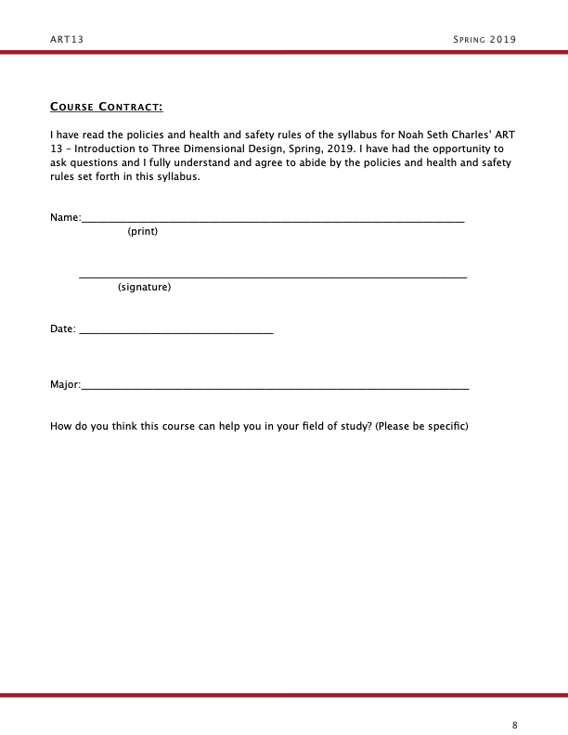

Slide 9
Creative and Critical Thinking Skills
Creative Thinking is the thinking we do when we generate ideas.
Critical Thinking is the thinking we do when we judge ideas
Notes:
So….….The over reaching goals of this course are to cultivate creative thinking and critical thinking skills….. these are by far the most important skills you can expect to get out of this course.….
By the end of the semester you should have the ability to creatively problem solve solutions to nearly any given problem….whether is related to 3-d design or not ….. that’s really the big picture goal, if you will. …..Lofty goals I know….but totally achievable!
No matter if you are an art major….if you want to study architecture…. want to go into the tech sector, or internal medicine… you name it….. these are skills that are going to be helpful throughout your entire life.
They are skills that highly valued and that are super sought after by employers….
And with creative and critical thinking skills, you will have a one-up on your competitors in your chosen career field ….and really quite frankly…will make you a better and more well rounded person in society as a whole.
—————————-

Slide 10
Three-Dimensional Design Elements
Form
Line
Plane
Volume
Mass
Space
Texture
Light
Color
Time
Notes:
Now for more of the sort of nuts and bolts of this course….
We are going to learn about the components of visual construction… We call them the Elements of Three Dimensional design…..
These are elements that we can pick apart and we can use to define any 3-D visual design or work of art…. We are going to utilize these elements over and over until they are second nature to you.
Things like form, space, color, mass…..the list goes on. These are the building blocks that we can use to create images and express ideas. These elements will essentially be the beginning of your visual literacy… our way to understand the visual world around us.
—————————-

Slide 11
Principles of Three-Dimensional Design
Unity and Variety
Balance
Scale and Proportion
Contrast
Emphasis
Repetition and Rhythm
Notes:
Then we are going to learn how to use and organize those elements into a structure that makes sense by applying the principles of art and design ….. things like unity, variety, contrast, scale, proportion, etc.
—————————-

Slide 12
Notes:
I absolutely love this quote… “Creativity is not a talent. It's a way of operating” …..….and I would also add, it’s definitely not something that you are born with….it’s something that is cultivated.
….so if you are thinking to yourself that you’re not artistic or your not creative…hey, I get it, I used to be the same way….interestingly enough, it was when I took this course as an elective …a number of years ago ….and that really changed my way of thinking.
So for any of you who feel that same way…..then…over the course of the semester…..I am going to make it my personal mission to change your mind!
If you feel like you are a creative person already….that’s awesome… and what this course is going to do is to help you increase your creativity ….and I am going to break it down super simply into in four easy steps….and these same four steps we are going to apply to each project we work on through this semester.
—————————-

Slide 13
Cultivating Creativity
Learning as much as you can about any given problem.
Experimenting with a variety of solutions.
Evaluating the work in progress.
Implementing your idea.
Notes:
Those steps are….

Slide 14
Cultivating Creativity
1. Learn as much as you can about any given problem.
Notes:
So…by the end of the semester, you will have the ability to conceptualize and develop ideas that are related to fields like: industrial design…. sculpture…. and architecture.
You’re also gonna be able to contextualize content that’s related to your own 3-D art and design projects.
—————————-

Slide 15
Cultivating Creativity
2. Experiment with a variety of solutions.
Notes:
You are going to be experimenting with a variety of solutions to 3-d design projects by designing and building projects using the elements and principles of design.
You’re also going to be able to recognize the various properties of different types of mediums and materials and apply them to a particular concept.
—————————-

Slide 16
Cultivating Creativity
3. Evaluate the work in progress.
Notes:
3. Evaluating the work in progress…. And we are going to do that together as a group.
You will learn to critically analyze your work ….and the work of others ….on both an emotional and intellectual level.
—————————-

Slide 17
Cultivating Creativity
4. Implement your idea.
Notes:
And lastly…. Implementing your idea….. So….you will be designing and building three dimensional projects using the elements and principals of design….resulting in the creation of a finished piece of original artwork.
—————————-

Slide 18
Cultivating Creativity
“The heart of all new ideas live in the borrowing, adding, combining, or modifying of old ones.”
“Do it by accident and people call you lucky. Do it by design and they’ll call you creative. ”
–Michael LeBoeuf
Notes:
Another quote that I think is great….
I’ts by Michael LeBoeuf, a former professor and author…. He said… “The heart of all new ideas live in the borrowing, adding, combining, or modifying of old ones.” “Do it by accident and people call you lucky. Do it by design and they’ll call you creative. ” ….and it’s so true.
We are not here to re-invent the wheel, but we are here to study what artists and designers have done before us and we are gonna use that knowledge as a stepping stone….
So instead of starting your learning curve way down here, we are going to apply that knowledge, so that you can start on the middle rung of the ladder and by the end of the semester, you are going to be well on your way to climbing to the top of the perverbial creative ladder.
—————————-

Slide 19
Notes:
You are also going to learn about a bunch of different materials…. plaster, metal, wood, clay, light, and also found objects.
Then after learning how to manipulate the material, you will learn ways in which you can express your ideas with any given material.
These are just a few finished examples of my former students work that came from this course….. Clay on the left… plaster on top…and painted balsa wood on the bottom.
—————————-

Slide 20
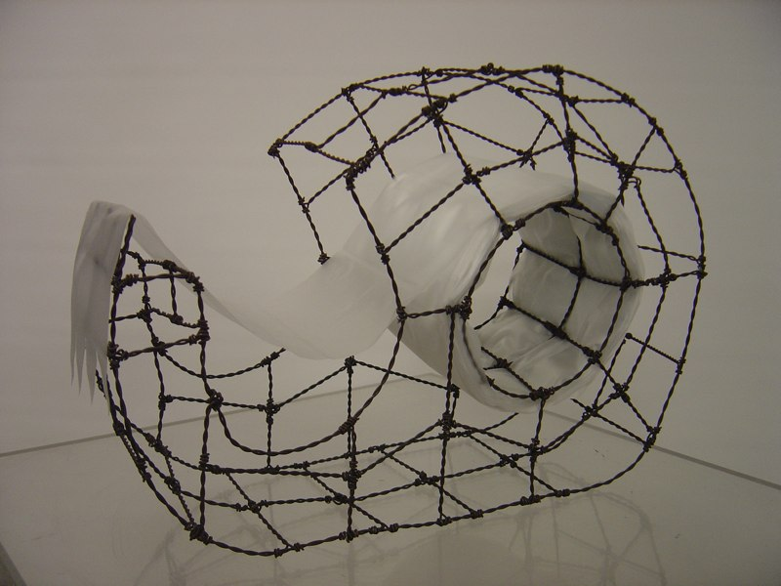
Linear Object Project
ART 13 - Spring 2019 - N. Seth Charles
Notes:
Alright…. So with that in mind I’d like to introduce your first assignment…. I have a detailed handout in your packet that you can refer to, but right now, I’m just going to give you the broad strokes….
So….. Your task will be to create a sculpture in the round…. Which basically means 3-d….it will have length, width, and most importantly depth. Right?
You are going to be able to walk around it and view your project from all sides.
—————————-

Slide 21
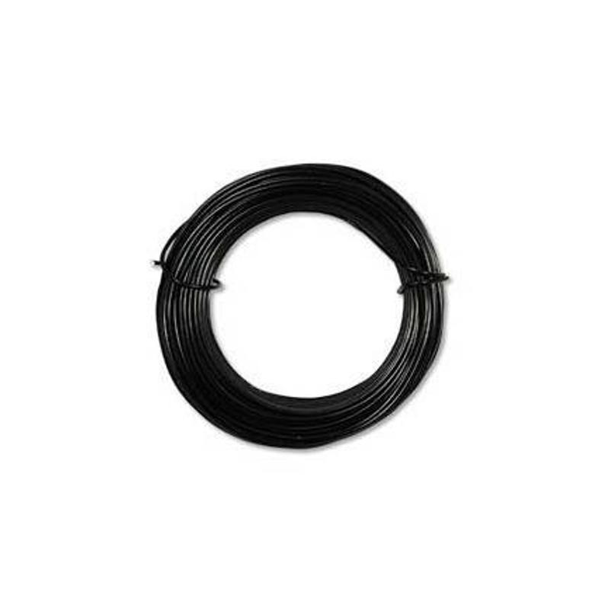
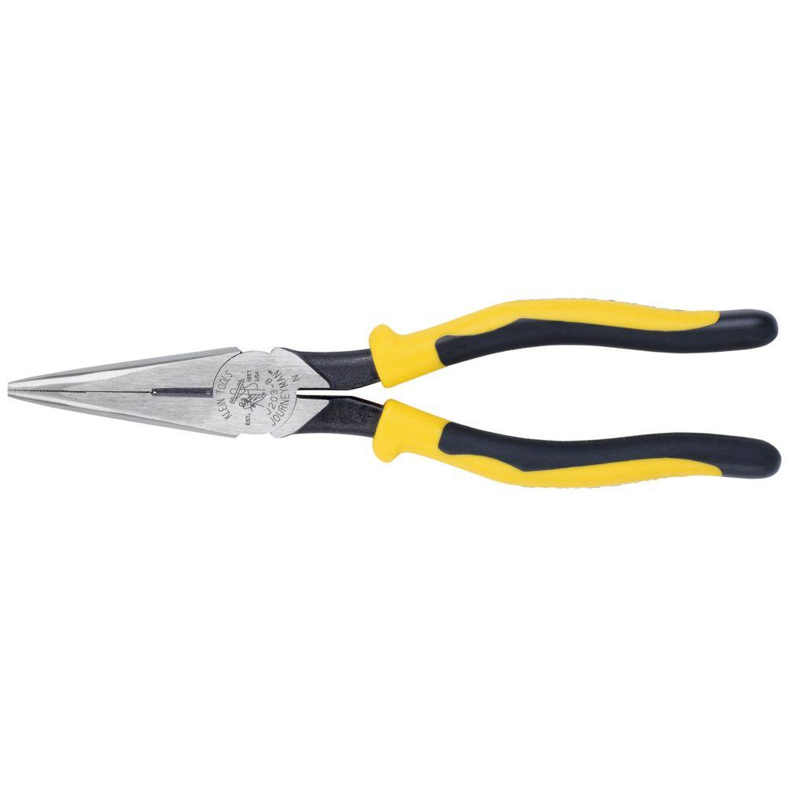
Notes:
Materials are super simple….and they will be provided for you….
You are going to use malleable wire, and needle nose pliers that have a wire cutter on them….On Tuesday, I’m going to demonstrate how to properly and safely use the pliers…and I’ll show different construction methods for working with wire.
——————————-

Slide 22
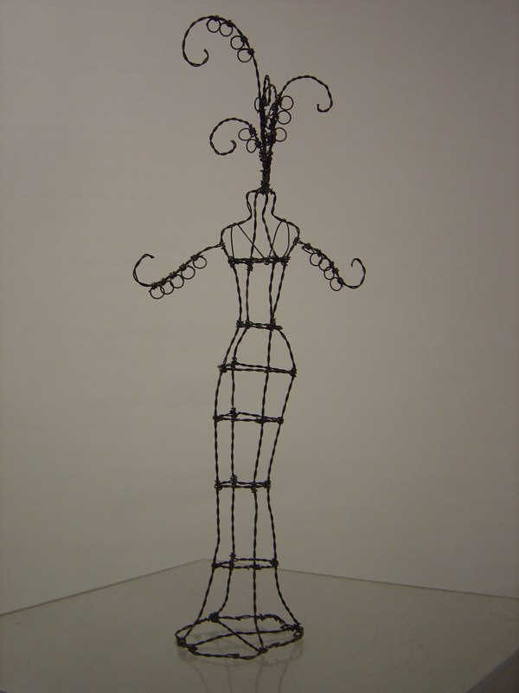
Notes:
Now for some specifics….this is the first part of your homework for the weekend…
So the first thing that you will need to do is choose an object that is visually interesting to look at … and really just as importantly…. Something that has meaning to you.
You are going to be spending a couple of weeks working to recreate your object, so make sure it is something that will keep your interest.
If you are unsure, feel free to pick my brain… you can stop by my office and chat….or shoot me an email with pictures of different items….whatever works you you…. It’s one of the things that I’m here for, so use me as a sounding board with any questions that you may have.
——————————-

Slide 23
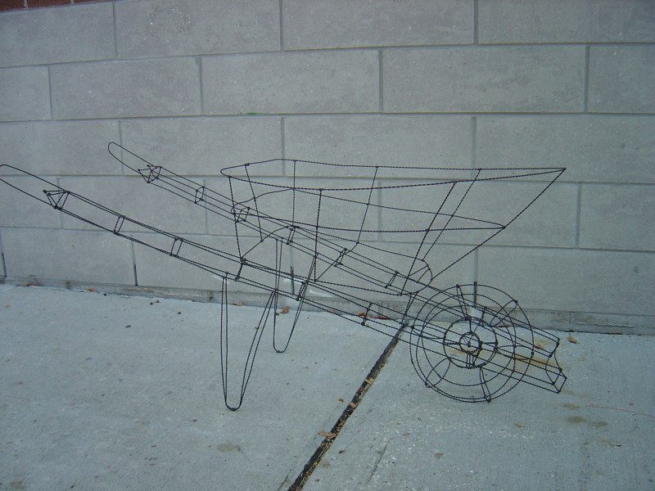
Notes:
Just a couple of considerations to keep in mind… Your object does need to be at least 18” in any direction…. It can be bigger, like in this life-size replica of an old wheel barrow…. But a minimum of 18” in either length, width, or depth.
You’re also going to need to be able to transport your object to class…. So when a former student told me he wanted to sculpt his fathers old wheel barrow that they had used to help escavate their family property…. Well…. I was a bit skeptical…..
But he kept it strapped down in the bed of his pickup truck and wheeled it into class every day…..and conveniently enough, he also put all his books and supplies in there so he didn’t have to make two trips…. So it ended up working out well for him.
—————————-

Slide 24
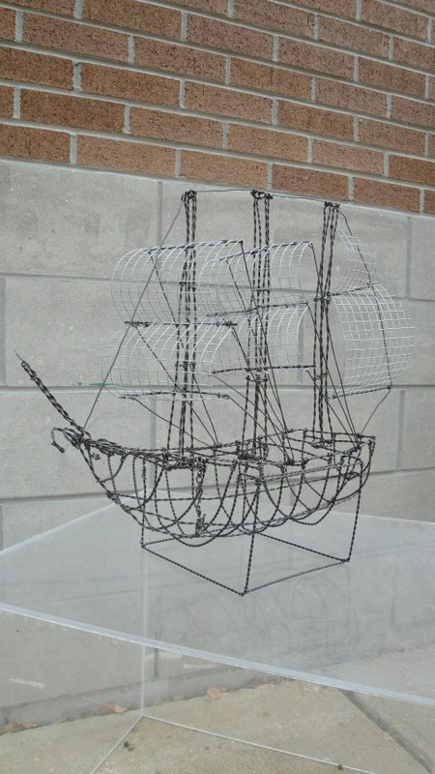
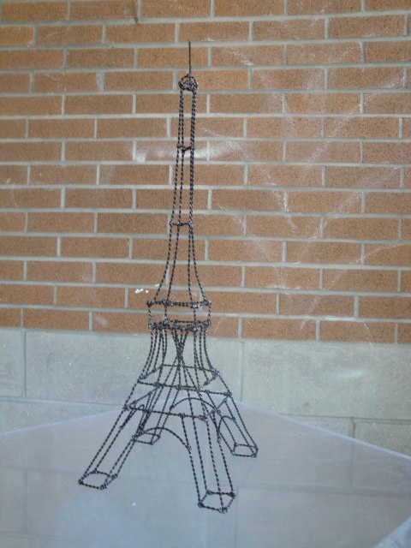
Notes:
So some more good examples of very meaningful objects…
The sailing ship here on the left was made my a former student of mine name Jose, who was a history major…..He brought in a model ship that his grandfather had built and passed down to him ….obviously an object that had significant value to him.
The example on the right was made by one of my non-traditional students who got proposed to underneath the Eiffel Tower in Paris….. And when they recently went back for their 20th anniversary, her partner bought her a statue of the Eiffel Tower to celebrate their milestone together. This, of course, is a recreation of that statue.
—————————-

Slide 25
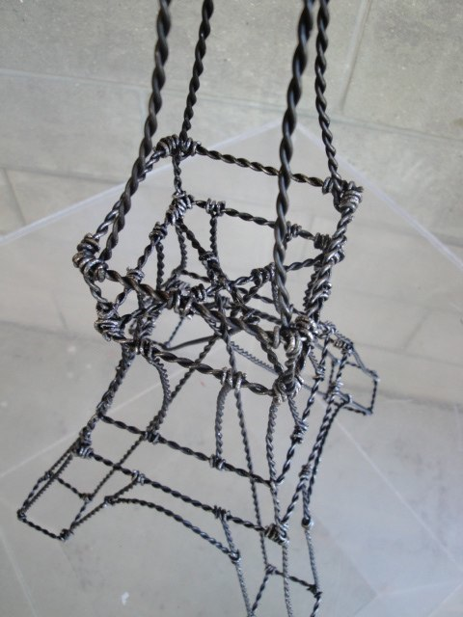
Notes:
And then I’ve included this detail image, just to show one of the construction methods….which again, I will demonstrate next class….
—————————-

Slide 26
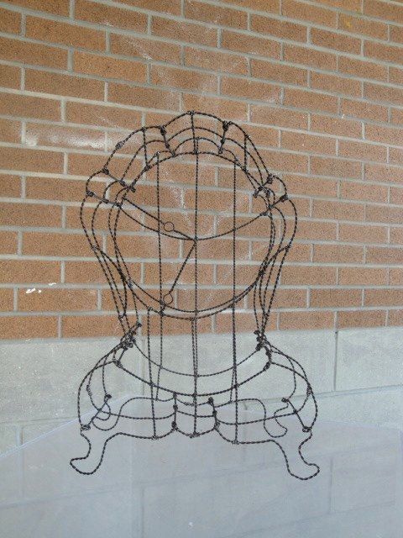
Notes:
So…..for Tuesday…..you will need to bring in your object, sketchbook, and pencils. We will talk specifics about these and other items you will need throughout the semester later today when we review our supply list.
—————————-

Slide 27
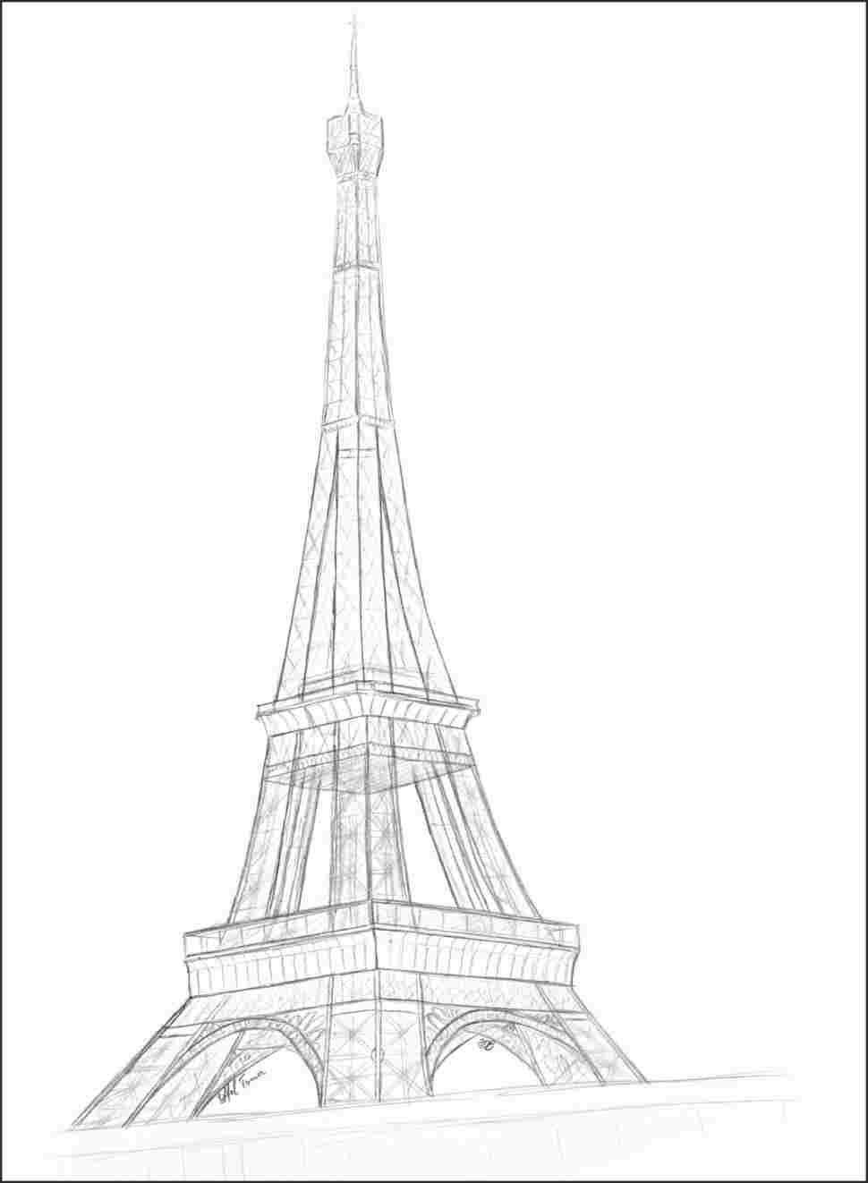
Notes:
You are going to start out next class using 2-dimensions….just your pencil and sketchbook.
You will draw your object from multiple perspectives….multiple sides…. And I will give a thorough demonstration on objective line drawing next class….
Now keep in mind….this sketch was done by a student who had already taken a drawing class….you don’t have to be great at drawing….these are just thumbnail sketches to rough out ideas…. But these sketches are going to help you understand how much wire you are going to need to create your object with …..
Then you will start to create your own object, translating those 2-d line drawings into a 3-dimensional object in the round.
—————————-

Slide 28
Homework
Review syllabus and sign course contract.
Purchase textbook and read pages 180-195.
Bring sketchbook, pencils and erasers.
Select your object and bring to class.
Notes:
Alright… now to wrap everything up for today…. Your homework ….which is due at the begging of class on Tuesday will be to ….
Number 1….review the syllabus… let me know if you have any questions…. and you will need to sign and complete your course contract which is on the last page of the syllabus.
Number 2….You will need to purchase your textbook and you will need to read pages 180 through 195 …that deals with form, line, and volume…. So our first three design elements.
You will need to purchase and bring in your sketchbook, your pencils, and erasers.
And lastly…. You will need to select your object and bring it to class on Tuesday…..
Are there any questions????
—————————-

